Slide 1

Ohio’s Alternate Assessment for Students with Significant Cognitive Disabilities
Refresher
Test Administration Training
Ohio Department of Education
American Institutes for Research
Notes:
Welcome to the Test Administration Training Module for Ohio’s Alternate Assessment for Students with Significant Cognitive Disabilities, or AASCD. This presentation covers important information you will need for administering the test, scoring student responses, and entering responses online.

Slide 2

Training Objectives
Know what you must do to prepare for the Ohio AASCD administration; be familiar with the testing materials and know what is allowed and not allowed during administration.
Understand how to determine where your students will begin the assessment.
Understand the process for entering student scores
in the online data collection system called the Data Entry Interface (DEI).
Notes:
By the end of this training, you will know all the “nuts and bolts” of test administration, including the design of the assessment and what types of accommodations can be provided for each student. You will be able to organize testing materials and set up the testing environment.
You will also know the deadlines for completing testing and entering data, and understand what steps you must take to ensure the security of the testing materials and the testing process.
You’ll learn how to score student responses and have an opportunity to practice scoring some videotaped task administrations, so you can check the accuracy of your scoring.
Finally, you will also understand the process for entering your students’ scores into the Data Entry Interface.

Slide 3
When Is the AASCD Administered?
February 21–April 14, 2017
Notes:
We will begin with an overview of the test and its eligibility criteria. The Ohio AASCD will be administered February 21 to April 14, 2017. Materials will arrive in districts on February 6, 2017.

Slide 4
AASCD Assignment by Grade
Form | Student Grade | Content Areas to Be Administered to Each Student
Grades 3–5 | 3 | ELA and Mathematics
 | 4 | ELA, Mathematics and Social Studies
 | 5 | ELA, Mathematics and Science
Grades 6–8 | 6 | ELA, Mathematics and Social Studies
 | 7 | ELA and Mathematics
 | 8 | ELA, Mathematics and Science
High School | 10 | ELA, Mathematics, Science and Social Studies
Notes:
There are three forms for each assessment. The forms are organized by grade bands: grades 3 through 5, grades 6 through 8, and high school.
The Test Administrator, or TA, should use the student’s enrolled grade to determine which form and content areas should be administered.

Slide 5
Who Takes the AASCD?
The reauthorized Individuals with Disabilities Education Act (IDEA, 2004) reflects the intent to extend educational accountability and reform to all students, including those with disabilities.
This legislation, along with the federal No Child Left Behind Act (NCLB), mandates that all students with disabilities be included in general state and district-wide assessment programs.
Notes:
It is the IEP team’s annual responsibility to determine how a student with disabilities will participate in Ohio’s assessment program.

Slide 6
Students with Disabilities
Assessment Participation
General assessment without accommodations (most students)
General assessment with allowable accommodations (many students with disabilities)
Alternate Assessment (small number of students with the most significant cognitive disabilities)
Notes:
Most students with disabilities participate in the general assessments with or without accommodations.
The AASCD is designed for a small number of students with the most significant cognitive disabilities, who are unable to participate in the general assessment, even with accommodations.

Slide 7
Participation Criteria
The student has a significant cognitive disability.
The student is learning content linked to (derived from) Ohio’s Learning Standards, i.e., Ohio’s Learning Standards–Extended.
The student requires extensive direct individualized instruction and substantial supports to achieve measurable gains in the grade- and age-appropriate curriculum.
The student cannot participate in the general statewide assessment with or without accommodations, as appropriate, based on his/her IEP.
Notes:
Ohio has high standards for all students, and all students are entitled to rich instructional programming. This includes students who will take the AASCD.
The decision-making framework for participation is in the Directions for Administration Manual (or DFAM), the Rules Book, and on the Portal.
The AASCD is appropriate only for students with the most significant cognitive disabilities.

Slide 8
Participation in the AASCD is NOT BASED on:
A disability category or label
Poor attendance or extended absences
Native language, social, cultural, or economic difference
Expected poor performance on the general education assessment
Academic and other services student receives
Educational environment or instructional setting
Percent of time receiving special education services
Notes:
Remember: The decision for a student to participate in the AASCD is an IEP team decision. It is not based on a disability label, poor attendance, poor performance on the OST, where instruction takes place, the types of special education services the student receives, or how long the student has been receiving them.
Next, we will discuss the importance of test security.

Slide 9
Test Security
Security is vital for future administrations, as well as the current administration.
You are responsible for ensuring the security of the content of all materials.
Your responsibility for the security of test questions and materials does not end when materials are returned.
Notes:
Each test contains questions and other materials that will be used on future forms of the test. Therefore, security is vital for future administrations, as well as the current administration.
You are responsible for ensuring the security of not only the physical test booklets, reading passage booklets, and printed manipulatives, but also the content of those materials.
Your responsibility for maintaining the security of test questions and materials does not end when materials are returned. You cannot tell other teachers or parents what the test contains.
When giving examples of test items, please use only the items that appear in this training. Do not use examples of actual test items.

Slide 10
Test Security Law
Under Ohio law (OAC 3301-13-05; ORC 3319.151; ORC 3319.99), releasing any test question or other content of a test to students or assisting students to cheat in any way may result in invalidation of test scores, termination of employment, suspension of license to teach, and/or prosecution.
A test incident must be reported to the Ohio Department of Education as soon as it becomes known to the district. Investigations involving breaches in security (violating the Ohio Administrative Code) must be documented and submitted to the Ohio Department of Education within 10 days following the conclusion of the investigation.
A summary of state security provisions is included in
Rule 3301-13-05 of the Administrative Code.
Notes:
Be aware that, under Ohio law, releasing any test question or other content of a test to students or helping students to cheat in any way may result in invalidation of test scores, termination of employment, suspension of license to teach, and/or prosecution.
A test incident must be reported to the Ohio Department of Education as soon as it becomes known to the district. Investigations involving breaches in security (violating the Ohio Administrative Code) must be documented and submitted to the Ohio Department of Education within 10 days following the conclusion of the investigation.
If you have questions or concerns about your responsibility for test security, consult your Board-adopted policy.

Slide 11
Ethical Use of Tests
Is this activity or behavior an ethical practice? | Yes | No
Making a copy of the alternate assessments and/or preparing a student study guide based on the alternate assessments. |  | X
Changing a student’s response. |  | X
Hinting to a student to reconsider any answers given on a test. |  | X
Revealing the test scores of one student to another student. |  | X
Providing teachers and counselors with information they need to interpret test results. | X
Preparing students for the alternate assessments by incorporating the extended standards in the appropriate subject curriculum. | X
Notes:
This slide shows different scenarios reflecting ethical practices in test administration.
Making a copy of the alternate assessments, changing a student’s response, hinting to a student to reconsider answers, and revealing a student’s test score to another student are all examples of activities that are not ethical.
However, it is allowable to enlarge the testing materials based on an individual student’s needs.
Next, we will discuss some changes happening for the Spring 2017 administration.

Slide 12

Changes for the Spring 2017 Administration
There is now one field test task on each form. It appears at the end of each form as Task 13. Every student, regardless of starting and concluding task, is required to take Task 13 on each test.
TA-Alt and TE-Alt user roles no longer exist in TIDE. All teachers, including those who teach students who participate in the AASCD, are included in the TE user role. Similarly, all test administrators, including those who administer the AASCD to students, are included in the TA user role. TA-Alt and TE-Alt users from the Spring 2016 administration now are TA and TE users, respectively.
Notes:
Beginning in 2017, there is one field test task on each form. It appears at the end of each form as Task 13. Every student, regardless of starting and concluding task, is required to take Task 13 on each test.
Another change is that TA-Alt and TE-Alt user roles no longer exist in TIDE. TA-Alt and TE-Alt users from the Spring 2016 administration now are TA and TE users, respectively.

Slide 13
Changes for the Spring 2017 Administration (cont.)
The Plan and Manage Testing, Test Completion Rates, and Test Status Code Reports tasks have moved from the Test Management Center in the Online Reporting System (ORS) to the Monitoring Test Progress in the Test Information Distribution Engine (TIDE). TEs, TAs and second raters are encouraged to confirm that a test has been submitted by following the steps provided in the TIDE User Guide, located on the Ohio Alternate Assessment Portal.
Notes:
Participation Reports, including the Plan and Manage Testing, Test Completion Rates, and Test Status Code Reports, have moved from the Online Reporting System (or ORS) to the Monitoring Test Progress section of the Test Information Distribution Engine (or TIDE). TEs, TAs and second raters are encouraged to confirm that a test has been submitted by following the steps provided in the TIDE User Guide, located on the Ohio Alternate Assessment Portal.

Slide 14
Test Design Accessibility
Notes:
In the next portion of the training, we are going to discuss the accommodations that are available for the AASCD and specific DOs and DON’Ts of administering the test.
Accommodations are used during daily instruction and may be listed on the student’s IEP.

Slide 15
Accessibility
Picture Communication Symbols™ (PCS™) have been used throughout the tasks and items.
If your student uses a different symbol for the same word, you may substitute that symbol for the one provided. For example:
™
™
Notes:
Throughout the assessment, response cards are used that contain the picture symbols created by Mayer-Johnson. Many teachers use these during instruction, when creating communication books, and when using Boardmaker™ or PCS™.
The Mayer-Johnson artists are wonderful, but occasionally there is more than one symbol for the same word. Therefore, if the assessment has a picture that is different from the one used in instruction, you may exchange it.

Slide 16
Accessibility (cont.)
Response Options:
Indicate each response option aloud, in order.
Indicate the concrete objects.
Use photographs used in instruction, if desired.
Have student touch or hold the object.
Substitute concrete objects when appropriate even if they are not listed in the adaptive instructions.
Notes:
Here are several ways the TA can make the Response Options accessible for students:
For each item, you will say each response option aloud, but you cannot use any type of voice inflection to lead the student to the correct response. You will also indicate each response option, but you cannot lead the student to the correct response by tapping, holding a hand over the correct response for a longer period of time, or in any other way indicating the correct answer. The answer options must be presented in the order listed in the test booklet.
During test administration, you may substitute photographs or concrete objects that are used during instruction for the provided response cards.
The student may hold or manipulate any of the objects used in the assessment.
Sometimes a student will point to one answer but say another. As Test Administrator, you must determine prior to administering the assessment which answer option you will accept: what the student says or what he or she points to.
A student may also repeatedly indicate that the last thing the Test Administrator says is the correct answer. The correct answers are randomized and are not always in the same location, so sometimes the last option will be correct. You should accept the answer and move on to the next item. Do not re-administer the item, and do not change the order of the answer options.

Slide 17
Accessibility (cont.)
Customizing:
Laminate materials if needed (remember, all materials are secure).
Provide calculators and scrap paper unless otherwise noted.
Allow student to use the AAC that is used during daily communication.
Add texture to lines, graphs, pictures, etc.
Refocus and repeat as needed.
Notes:
The TA may customize materials on the AASCD:
Response cards and posters can be laminated if needed. However, these materials are secure and should only be handled by the Test Administrator and not left in a room where they may be seen by others.
On the mathematics assessment, calculators and scrap paper are allowed unless otherwise noted.
You should allow the student to use his or her communication device when taking the assessment. This should be the same device that the student uses during daily instruction and communication, as specified in the student's IEP.
You may add texture to lines, graphs, and pictures if needed.
Refocusing the student’s attention on the task is allowed, even though there are no specific provisions for it in the script.

Slide 18
Accessibility (cont.)
Reading:
Read passage aloud.
Read answer options aloud.
Reread passage (do not lead student to correct answer).
Take breaks as needed (Test Administrator or student).
  Do not re-administer any items when you return.
Notes:
The AASCD has accessibility features built-in to the assessment:
TAs can always read the passage and answer options aloud, and the passage can be re-read as often as needed. For the reading assessment, you will frequently be directed to re-read a specific page or paragraph. But when reading aloud, you cannot lead the student to the correct answer in any way.
This assessment is not timed; therefore, you should take a break or stop the administration if the student becomes fatigued or ill, or if other circumstances require you to stop. The breaks can be very short or even continue into the next day. When you restart the assessment, you may reread the passage or reorient the student to the task.
For example: “Yesterday we were taking a test and we were talking about adding numbers.” The last item cannot be re-administered. Remember, you can never re-administer any item for which a student has already given a response.

Slide 19
Appropriate Encouragement
What do you usually do to praise or encourage the student?
  High five
  “Great!”
  “Way to go ______!”
  “Awesome!”
Caution: Do not lead the student to the correct answer for the next item.
Notes:
During the assessment, you may provide appropriate encouragement that affirms that the student is working hard, paying attention or behaving appropriately.
This encouragement must not lead the student to the correct answer.

Slide 20

Access Limitations
Clearly marked in setup
  Do not administer item 1 to students who are blind.
  Administer items 2, 3, 4, 5, 6 to all students.
Note which items are Access Limited when you review the tasks/items prior to the assessment.
A bubble is provided for all items marked “Access Limited (A).”
Notes:
There are limits to the accessibility of certain items. The teacher review committees have looked at the assessment and determined that some items are not accessible to students who are blind or deaf.
When you are reviewing the test materials, you should mark the ones that are access limited. This will be helpful as you are administering the assessment.
These items are listed following the setup page for that task. Do not administer these items to a student who fits the description listed under Access Limitations. Simply mark the item as “Access Limited (A),” and move on to the next item.
If an item is not marked “Access Limited,” then you should administer the item to all students.
In this example, items 2, 3, 4, 5, and 6 are administered to all students. Only item 1 is not administered to a student who is blind. Not administering this item will not affect the student’s score.

Slide 21
Getting Ready
Notes:
In the next section, we will discuss how to prepare for administering the AASCD.
To allow you sufficient time to prepare for test administration, your Building Coordinator will provide the AASCD materials prior to the opening of the testing window.
As a TA in possession of test materials, you must keep materials secure at all times. When you are not using the materials, they are to be kept in a secure location, such as a locked cabinet. Copies may not be made for your own records, and no part of the tasks may be sent via email.

Slide 22
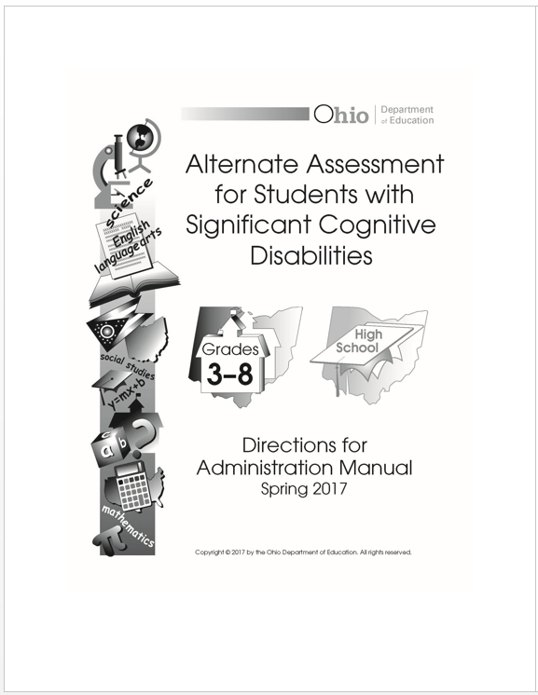
Test Administrator Responsibilities
Read the Directions for Administration Manual.
The TA must score and enter the student responses in the DEI. This information is located in DEI User Guide located on the Portal.
Notes:
Make sure that you read the Directions for Administration Manual or DFAM. You will be scoring and entering the student’s responses in the Data Entry Interface, or DEI. This document is available on the Portal.

Slide 23
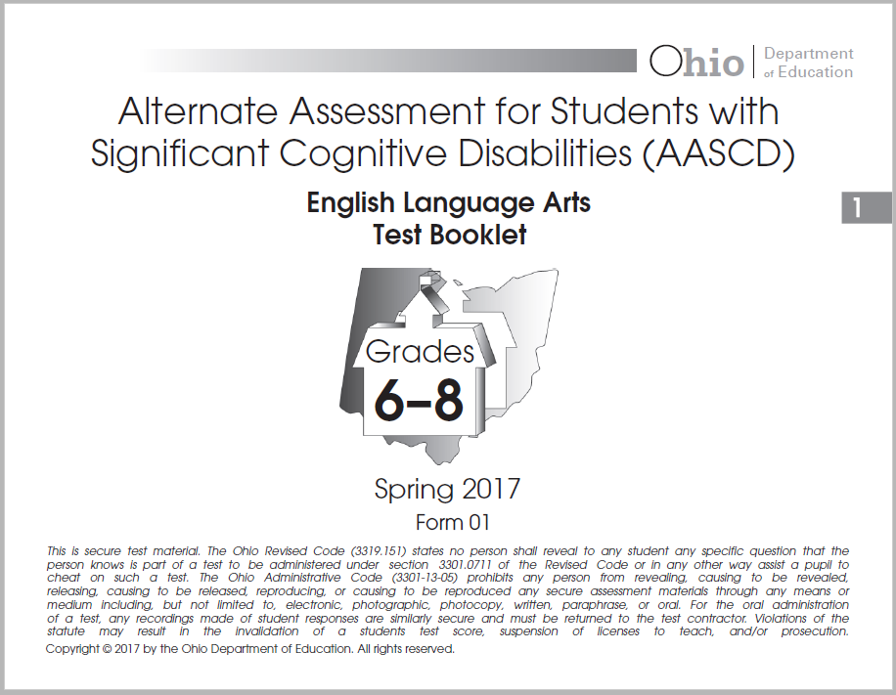
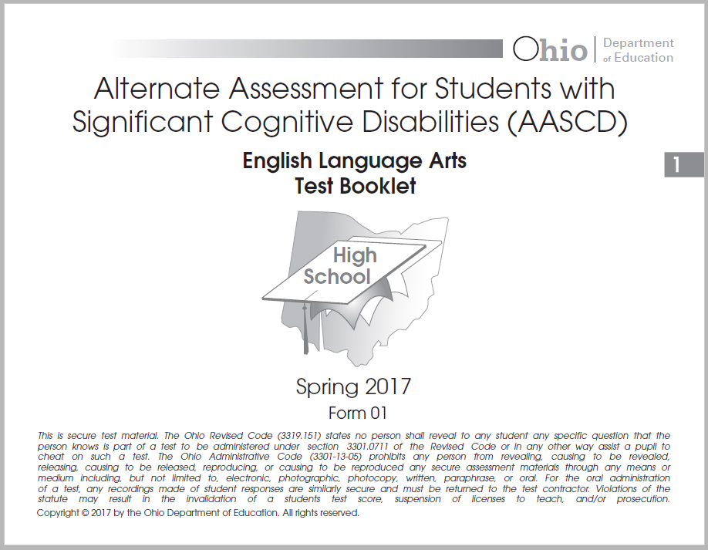

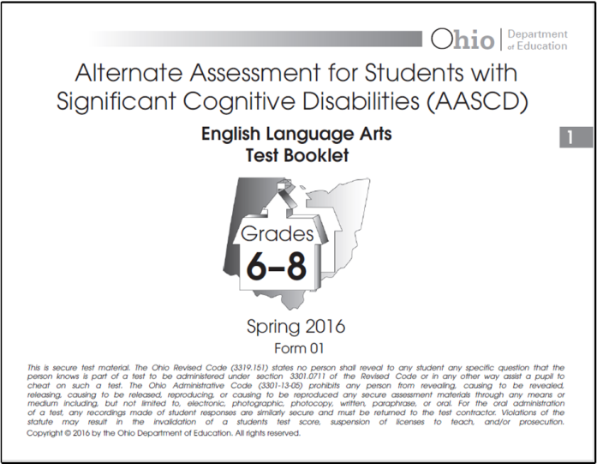
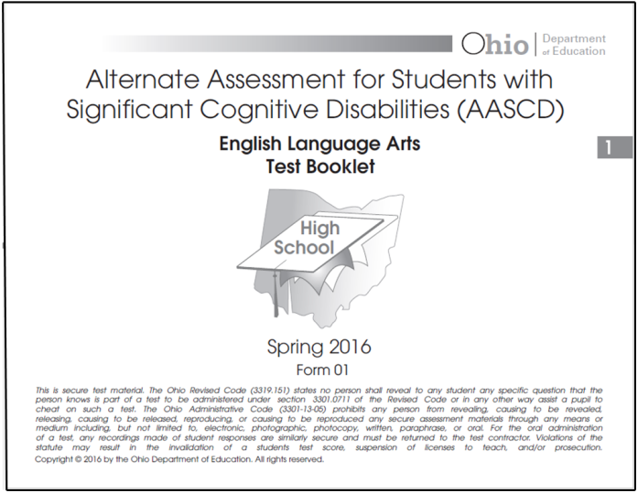
Where to Begin
Organize your assessments by grade band and content area.
Notes:
When you receive your materials, one of the first things you should do is make sure that these are the correct test materials for your students. Remaining organized is the key to an error-free administration.

Slide 24
Location Tips
The Ohio AASCD is administered orally in a one-to-one situation.
Determine whether you need to administer the assessment in a room other than your classroom. Students may perform better in a quiet location, but they may need time to get accustomed to a new environment.
Determine whether you will need to arrange to have any special equipment (seating, table) moved to the assessment location.
Conference tables may not be at the proper height for optimal student performance.
Consider the student’s optimal time of day.
Notes:
Here are some tips to remember when you are deciding where to administer the assessment:
Each assessment is administered orally to an individual student. It is not to be administered in a group or within hearing distance of other students.
You will need to determine whether to administer the assessment in a room other than your classroom. Some schools have a testing room in a guidance counselor’s office or a secluded room in the library. As an alternative, the test can be administered when the remainder of the class is at another activity. If your student does not adjust well to new settings, you may provide instruction in the new location prior to administration.
If you decide to use a different room, you will need to arrange to have any special equipment (seating, table) moved to the assessment location.
Some tables in other rooms may not be the appropriate height for all students. This is especially important if the student requires a special chair or sits in a low chair. In this instance, the table in another room may be too high.
The other thing to remember when scheduling the test administration is the student’s optimal time of day. Some students do their best work at the beginning of the school day while others do better in the afternoon. This is your decision.

Slide 25
Before Test Day
Schedule a location in your school to administer the assessment.
Determine the accommodations that your student(s) will need.
Schedule an assistant to help you manage
behaviors when testing students with specific behavioral concerns.
Notes:
Create a schedule to prepare for test administration by determining approximately how much time you will need to administer tasks to each student.
You should allow some flexibility in scheduling, because students may not always be available for testing during the time scheduled, and you should always plan for the accommodations that each student will need.

Slide 26



Test Administrator Provided Materials
Materials typically used in instruction
Not significantly different
Age and grade appropriate
Dry erase markers or any erasable marker
Notes:
Occasionally you will need to provide some test administration materials. These materials are items used during daily instruction and are familiar to the student. Materials used within a task or item should be similar in size, so that an object does not cue the answers. Items should always be age- and grade-appropriate.
Prior to test administration, you will receive a list of the materials you need to provide. The list is not extensive and should not place any burden on you.

Slide 27
Advance Preparations
Read through each task.
Determine which teacher-provided materials you will need.
Organize these materials to ease assessment administration.
Consider administering one content area to all of your students and then moving to the next content area.
Notes:
You should become familiar with the materials prior to AASCD administration. Reading through the script is an important initial step. You will receive test booklets, spiral-bound books of passages, posters, and sets of response cards for each grade in which you will administer assessments.
Staying organized will make test administration run smoothly. You may want to consider administering one content area to all students, and then putting those materials away and moving to the next content area.

Slide 28
Other Preparations
Practice. Practicing will make the test administration go more smoothly.
Before test administration, determine whether any of the students’ assistive technology devices need special programming.
Consider administering the assessment first to a student with minimal challenges.
Notes:
Here are some other things to think about when preparing to administer the assessment.
Practicing will make the assessment administration go smoothly.
If a student uses any assistive technology, double check that it is working properly prior to administering the assessment,. You may need to pre-program some devices, enlarge the picture symbols used as response options, or determine how you will put the response options on switches. The assessment can not be loaded onto any device or computer.
Because of the diverse needs of students who take the assessment, consider administering the assessment to the students with minimal behavioral, visual, and communication challenges first.

Slide 29
Suggestions
  Clip the printed response cards to each task.
  Place your manipulatives in plastic bags or small baskets.
  Place a fastener on the printed manipulatives and place them on fabric strips.
  Non-trained staff who have a license/certificate/permit from ODE and are Test Coordinator (TC) approved can help prepare materials.
Notes:
Suggestions from TAs on how to stay organized include:
Clipping the response cards to each item in the test booklet, or clipping them to the setup page of each task;
Placing the response cards for each task in plastic sandwich bags;
Placing the response cards, organized in the order of administration, in a small plastic basket; or
Fastening the response cards to fabric.

Slide 30
Scoring the Ohio AASCD
Notes:
In the next section of this presentation, we will discuss how to score the AASCD.

Slide 31
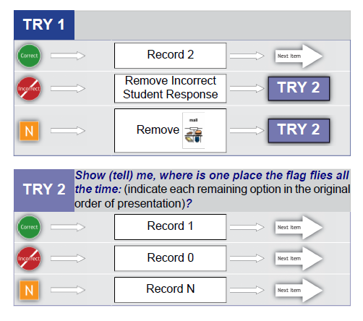
Scoring Procedures
Test Administrator scores the assessment as it is administered.
Scores can be recorded online or on the optional scoring worksheet but not in the test booklet.
An optional scoring worksheet is provided to assist during test administration.
Notes:
You will score the AASCD as you administer the test, based on the scoring instructions to the right of each item. You can record scores on the optional scoring worksheet, but all scores must be entered into the online Data Entry Interface, or DEI.

Slide 32
Scaffolding
If the student answers
Correctly on Try 1, record 2, and move to the next item.
If the student answers incorrectly or does not respond, remove ____,
and move to Try 2.
Then follow the Try 2 scoring procedures.
Notes:
Ask the question as it appears in the script. If the student answers the item correctly, record 2, and move to the next item.
If the student answers incorrectly, simply remove the student’s incorrect response, and move to Try 2.
If there is no response, remove the response card indicated in the directions and then move to Try 2.
Make sure that you remove the correct card.
When administering the item again, ask the question and remember to leave the response cards in the original order of presentation.
If the student answers the item correctly, record 1, and move to the next item.
If the student answers the item incorrectly, record 0, and move to the next item.
If the student does not respond, record N, and move to the next item.

Slide 33
Scoring Rubric
Engagement
Provide evidence
  that the student is engaged in the task; and
  that the student shows extended focus and persistence.
The Test Administrator makes a judgment using a scoring rubric.
Notes:
The tasks on the AASCD increase in difficulty as the student progresses through the assessment.
The early tasks have the lowest complexity and appear in the first two or three tasks that are scored on an engagement rubric.
The engagement score provides evidence that the student was engaged in the task. You will make a judgment based on the following scoring rubric.

Slide 34
Engagement Rubric
Score 4: Sustained involvement
Score 3: Generally maintained involvement
Score 2: Intermittent/irregular involvement
Score 1: Fleeting awareness with little or no involvement
No response: Does not demonstrate engagement in the task
Notes:
Based on your observation of the student’s involvement, you will record one of the following scores as appropriate:
A score of 4 points indicates sustained involvement:
For example, the student consistently attended to the Test Administrator’s actions or participated with intention or made appropriate vocalizations in response to the object.
A score of 3 points indicates generally maintained involvement:
For example, the student generally attended to the Test Administrator’s actions or touched or pointed to objects or allowed the Test Administrator to place his or her hands on the object.
A score of 2 points indicates intermittent/irregular involvement:
For example, the student intermittently attended to the Test Administrator’s communication and actions or moved toward an object or shifted gaze appropriately.
A score of 1 point indicates fleeting awareness with little or no involvement:
For example, the student only fleetingly attended to the Test Administrator’s communication and actions or exhibited a momentary change in movement or vocalization or opened his or her eyes or moved them toward materials.
No response indicates that the student does not demonstrate engagement in the task:
For example, the student did not demonstrate any awareness of the activity taking place.

Slide 35
Writing Rubric
Writing Rubric–3 Point Scale
The student earns one point for each of the following:
  Including correct beginning capitalization
  Including correct ending punctuation
  Giving a response relevant to the topic and/or at least one relevant detail
Score 3: The student’s response includes at least one complete sentence that includes all criteria.
Score 2: The student’s response includes a complete sentence that includes at least two criteria.
Score 1: The student’s response includes a complete sentence with any one of the criteria.
Notes:
The Writing Rubric item type requires students to generate a sentence. The test administrator will use a rubric to determine the student’s score. In order to earn any points, the student’s response must be a complete sentence.
The student earns one point for beginning the sentence with a capital letter. The student earns another point for correct punctuation at the end of the sentence, and one more point from giving a response that is relative to the topic; the maximum possible score is 3 points.

Slide 36
Writing Rubric (cont.)
Writing Rubric–3 Point Scale
The student earns one point for each of the following:
  Including correct beginning capitalization
  Including correct ending punctuation
  Giving a response relevant to the topic and/or at least one relevant detail
Score 0: The student’s response does not include any of the required criteria.
No Response: The student does not respond.
Notes:
The student earns a score of zero for a response that does not include a complete sentence or does not include any of the required criteria.
Students may dictate a response to the TA. Students must indicate punctuation and capitalization in their response. See Ohio’s Accessibility Manual Appendix C, for more information about the use of the scribe accommodation. Also see Section XII. Making Ohio’s AASCD Tasks Accessible of the DFAM for more information about allowable response modes and assistive technology.

Slide 37
Writing Rubric (cont.)
Details regarding relevance:
  Rubric says one relevant detail–can be broadly interpreted.
  Mention of topic only is acceptable (e.g., endangered species topic; student writes “I like tigers.” or “Tigers are scary.”)
  Relevant detail but a copy of text from passage or poster: “Tigers are disappearing.” This is acceptable if it follows the convention requirements of the rubric. We are phrasing the prompts so that there is little likelihood of an opportunity to use a sentence directly from task-related text.
Notes:
The student’s response must be relevant to the topic, but what counts as relevant can be broadly interpreted. For example, just mentioning the topic or copying relevant text from the passage may be considered as a relevant detail.

Slide 38
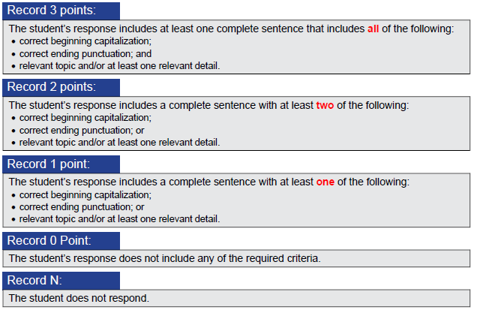
Writing Rubric (cont.)
Response must be a complete sentence.
Sentence length does not matter as long as it is a complete sentence.
Rubric does not include spelling. Phonetic spelling is acceptable.
Notes:
Recognizable word order is required. For example, “The boy is tired.” is a valid response, and “The boy tired is.” is not a valid response. Beyond that, syntax and grammar are not counted.
Since the rubric does not specify any type of case agreement, students should not be penalized for errors in subject/verb agreement. “The boys is going to the game.” could be a valid response.

Slide 39
Determining the Starting and Concluding Tasks
Notes:
This next section of the training will help you determine how to start and end the assessment.

Slide 40
Starting Point
Option 1–Starting Points Table
Notes:
You may use the Starting Points Table to determine the starting point for students who have Spring 2016 ELA and math scores for grade bands 3–5 and 6–8.

Slide 41
Starting Points Table
  Students tested during the Spring 2016 administration:
  Only applies to ELA and math scores for grade bands 3–5 and 6–8.
  Use the student’s previous score from the spring administration (found in the Online Reporting System).
  Once you have retrieved the student’s score, use the Starting Points Table (found in the DFAM) to determine the starting point for each student.
Notes:
To determine the starting task, you will need the student’s score from the Spring 2016 administration. You can find Spring 2016 scores in the Online Reporting System. TAs who do not have access to online score reports can request student scores from their test coordinator.
Once you have retrieved the student’s score, use the Starting Points Table found on the Portal and in the DFAM to determine the starting point for each student.

Slide 42
Starting Points Table (cont.)
Starting tasks based on Spring 2016 AASCD scale score
Starting Tasks for ELA
Grade Band | If the Student’s Spring 2016 ELA Score Was in This Range … |  | Then Start the Student at …
Grade 3–5 | Limited or Basic | 200–381 | Task 1
 | Proficient | 382–410 | Task 3
 | Accelerated or Advanced | 411–575 | Task 6
Grade 6–8 | Limited or Basic | 200–399 | Task 1
 | Proficient | 400–421 | Task 3
 | Accelerated or Advanced | 422–575 | Task 6
Notes:
Here is an example of the starting points table for ELA.

Slide 43
Starting Points Table (cont.)
Starting tasks based on Spring 2016 AASCD scale score
Starting Tasks for Math
Grade Band | If the Student’s Spring 2016 Mathematics Score Was in This Range … |  | Then Start the Student at …
Grade 3–5 | Limited or Basic | 200–389 | Task 1
 | Proficient | 390–426 | Task 3
 | Accelerated or Advanced | 427–575 | Task 6
Grade 6–8 | Limited or Basic | 200–399 | Task 1
 | Proficient | 400–436 | Task 3
 | Accelerated or Advanced | 437–575 | Task 6
Notes:
And here is an example of the starting points table for math.
The tables for both ELA and math are located in Appendix F of the DFAM.

Slide 44
Starting Point
Option 2: Student Placement Questionnaires
Notes:
In this section, you will learn how to use the Student Placement Questionnaire, or SPQ, to determine the starting task for your students. You must use the SPQ for all students who do not have a previous score. However, you can also use it for all of your students.

Slide 45
Student Placement Questionnaire (SPQ)
The Student Placement Questionnaire (SPQ) is designed to identify the most appropriate starting task for each student in ELA, mathematics, science, and social studies for the AASCD.
The SPQ will be used for all students who do not have a valid score for the Spring 2016 AASCD assessment.
The TA is to answer each SPQ item as accurately as possible, based on their classroom experience with the student.
Notes:
The Student Placement Questionnaire (SPQ) is designed to identify the most appropriate starting task for each of your students in reading and mathematics.
Answer each SPQ item as accurately as you can, based on your classroom experience with the student.

Slide 46
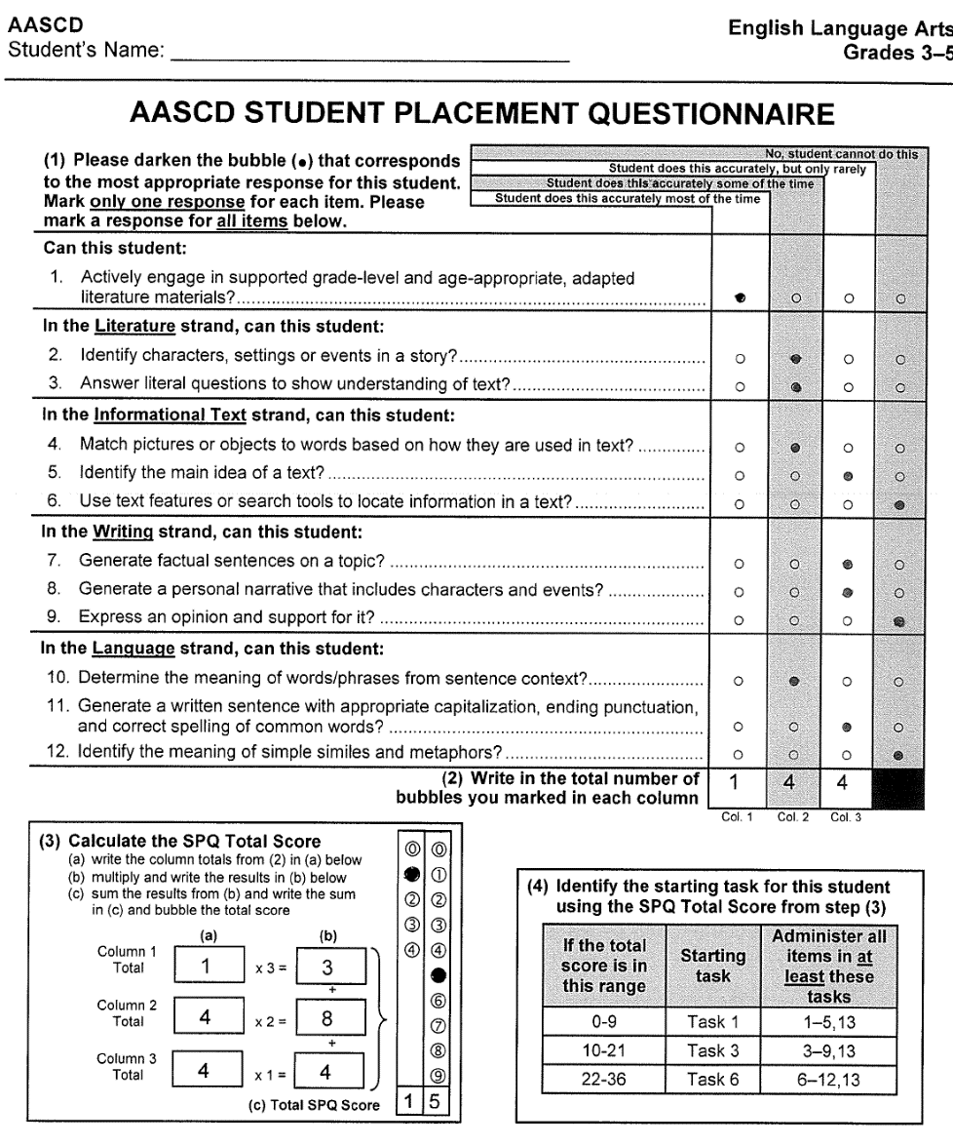
SPQ Steps Summary
Step 1
Step 2
Notes:
Step 1 is to answer the questions and fill in the bubbles.
For step 2, write the total number of darkened bubbles in each column.

Slide 47
SPQ Steps Summary
Step 3
Step 4
Notes:
For step 3, calculate the score in the bottom-left of the form.
Finally, for step 4, locate the starting task based on the total score in step 3.

Slide 48
SPQ Dos and Don’ts
Do
complete all items on the SPQ for each student in each content area;
follow the instructions carefully; and
complete the SPQ before the AASCD administration window begins.
Don’t
assume that all students will begin the assessment with the same task;
assume that a given student will start at the same point in each content area; and
wait until the last minute to complete each student’s SPQ.
Notes:
You must complete all of the items on the SPQ and follow all directions to determine the starting point. Please don’t assume that all of the students in a class will begin the assessment at the same point. All students are different.
You must complete the SPQ for each student in each content area. A student may start at task 3 in math and task 6 in ELA.

Slide 49
Summary
The Starting Points Table and the Student Placement Questionnaire (SPQ) provide the initial starting point for a student’s administration. The minimum number of tasks and specific tasks that must be administered to each student for each starting point are specified below:
Starting Task | Administer all items in at least these tasks
Task 1 | 1–5, 13
Task 3 | 3–9, 13
Task 6 | 6–12, 13
Notes:
The SPQ and Starting Points Table provide the initial starting point for a student’s administration. This table displays the minimum number of tasks and specific tasks that must be administered to each student for each starting level.

Slide 50
Summary (Cont.)
  Starting at Task 1: Tasks 1–5, 6, 7, …
  Starting at Task 3: Tasks 3–9, 10, 11, …
  Starting at Task 6: Tasks 6–12
Field Test Task
1 2 3 4 5 6 7 8 9 10 11 12 13
Field Test Task
3 4 5 6 7 8 9 10 11 12 13
Field Test Task
6 7 8 9 10 11 12 13
Notes:
Students starting on Task 1 must be administered at least Tasks 1–5 and Task 13.
Students starting on Task 3 must be administered at least Tasks 3–9 and Task 13.
Students starting on Task 6 must be administered at least Tasks 6–12 and Task 13.

Slide 51
Starting Point Adjustments
Notes:
In the next section, we will discuss what to do if the starting task is too difficult.

Slide 52
Entry Points–Starting Task
Determine where to begin the assessment
  Task 1, 3, or 6
  Starting Task 3: drop back to Task 1
  Starting Task 6: drop back to Task 3
Fewer than 3 points on starting task, adjust back
(except for Task 1)
3 points or more on starting task, move to next task
Notes:
When your student does not earn 3 points on the starting task, you should drop back to the next starting level. For example, if the student started on Task 6, drop back to Task 3. If the student started on Task 3, drop back to Task 1.
Students who begin with Task 1 will always continue the assessment, even if they do not score 3 points.

Slide 53
Concluding Tasks
Notes:
In the next section, we will discuss the information you need in order to end the administration of the assessment appropriately.

Slide 54
Concluding Task
If the student earns six or more points on the last required task, continue to the next task using the following directions.
Notes:
There is no ceiling for the AASCD; if a student earns 6 or more points in the last task of the required set, you should move on to administer the next task.
Please note that if a task has fewer than six total attainable points, you should continue the assessment if the student earns the maximum number of points attainable. For example, if a student earns five points out of five possible points, then the student has responded successfully, and you should proceed to the next task.

Slide 55
Ending Point Summary
Possibilities
  Successful on Task 5
  Successful on Task 9
  Successful on Task 12
Field Test Task
1 2 3 4 5 6 7 8 9 10 11 12 13
Field Test Task
3 4 5 6 7 8 9 10 11 12 13
Field Test Task
6 7 8 9 10 11 12 13
Notes:
For example, if a student starts on Task 1 and successfully answers Task 5, you should move on to administer Task 6.
If a student starts on Task 3 and successfully answers Task 9, you should move on to Task 10.
All students should be administered Task 13, regardless of their other answers in the assessment.

Slide 56
Stopping Rule
Fewer than 6 points on concluding task, end administration
6 points or more on concluding task, move to next task
Notes:
Following the set of required tasks that must be administered to the student, you will continue administering additional tasks as long as the student continues to score 6 or more points on each task. If any task has fewer than 6 points possible, continue if the student earns the maximum number of points possible.

Slide 57
Scoring Fidelity and Second Raters
Notes:
Next we will focus on scoring fidelity, making sure that scoring is consistent.

Slide 58
Scoring Fidelity
The AASCD is administered and scored by the Test Administrator.
Fidelity of administration and scoring is monitored by using a second rater to verify, through a sampling of administrations, that all procedures were followed.
A sampling of teachers and students will participate.
Notes:
The AASCD is administered and scored by the TA.
Fidelity of administration and scoring will be monitored by a second rater whose job is to verify, through a sampling of administrations, that all procedures were followed. The second rater does not participate in administering the assessment. This person only records the student scores and enters their observed scores in the Data Entry Interface (DEI) for the second rater.
A sampling of teachers and students will participate in second rating.

Slide 59
What Is the Second Rater Procedure?
For the teacher and student sampled, a trained teacher or other certified staff member (the second rater) observes the assessment administration.
The second rater scores the student responses at the same time as the Test Administrator and independently enters his/her scores into the DEI.
The Test Administrator’s score is the official scoring record; the second rater scoring is collected to compute scoring consistency.
The second rater does NOT score Task 13, the field test task.
Notes:
Unlike a Test Administrator who must be an employee of the district, a second rater is not held to this requirement. It may be that another teacher, administrator or other trained individual from the same building or district serves as the second rater, but it is also okay to have second raters from across districts when necessary. However, the same certificate, license, permit and training requirement applies to both Test Administrators and second raters.

Slide 60
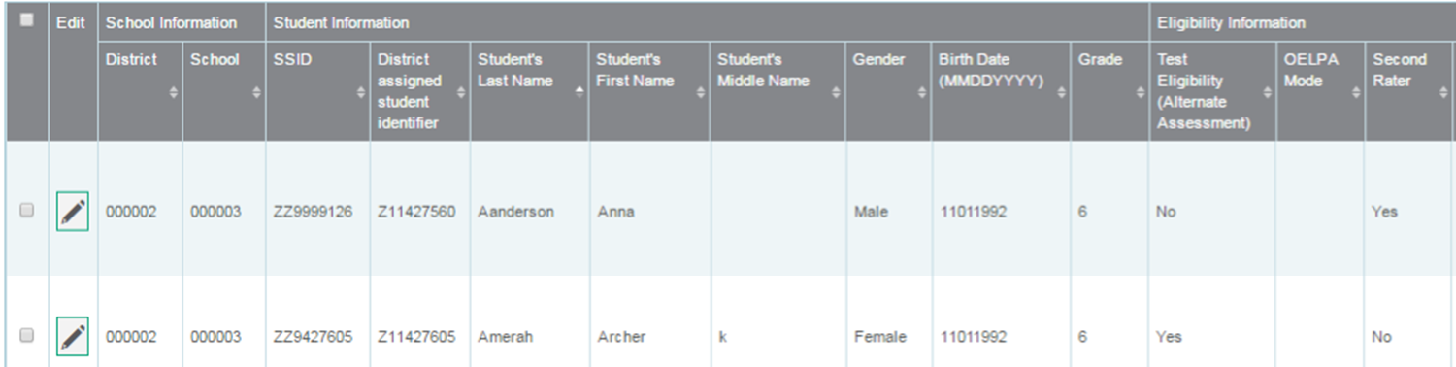
Second Rater Assignments
Second rater assignments will be published in TIDE January 30, 2017.
Make sure to check before starting the administration.
See the TIDE User Guide for directions to locate second rater assignments in TIDE.
Notes:
The graphic illustrates that second rater assignments will be indicated with either a “Yes” or “No” next to the student’s information in TIDE. This information will not be released until January 30.

Slide 61
Receiving and Returning Materials
Notes:
Next we will describe the AASCD materials that Test Administrators and Test Coordinators will receive, and how to return them after test administration.

Slide 62
District Materials
District Packing List
School Box Range Sheet
Copies of the School Packing List(s)
AASCD DTC Kit containing:
  Test Coordinator Manual
  Directions for Administration Manual
  Return Shipping Labels
  Secure Materials Resolution Form
Notes:
Let’s start with the materials the district will receive.
Each District Test Coordinator (or DTC) will receive:
A Test Coordinator Manual,
A Directions for Administration Manual,
Return Shipping Labels, and
A Secure Materials Resolution Form

Slide 63
Test Administrator Materials
Test Administration Kit:
  Test booklets
  Reading passage booklet for ELA for grade bands 3–5 and 6–8
  Bag of printed manipulatives specific to each content area
  Physical manipulatives (if applicable)
  TA Kit memo and checklists
  A list of test materials to be provided by the TA
  Directions for Administration Manual
Notes:
The test administration kits are packed by grade band. There will be one kit for grade band 3–5, one for grade band 6–8, and one for high school.
Each test administration kit contains:
Test booklets,
Reading passage booklets,
A bag of printed manipulatives specific to each content area such as posters and response cards,
Bags of physical manipulatives, if applicable,
A TA kit memo, listing the materials to be provided by the teacher or test administrator, and
A Directions for Administration Manual

Slide 64
Other Materials
Optional Scoring Worksheets:
  Located in the Directions for Administration Manual Appendix B
  Used to record students’ scores
  Scores must be transferred into the DEI
  If used, return with all printed materials
Notes:
The optional scoring worksheet can be used to record the student’s responses. Then the contents of the worksheet must be transferred into the online Data Entry Interface.
If you use the optional scoring worksheet, please return it along with all other printed materials.

Slide 65
Returning Materials
Return test materials to the BTC according to district procedures.
Follow the instructions in the DFAM for reassembling the TA kits.
  All printed materials must be returned in the kits.
  Physical manipulatives may be kept.
  Directions for Administration Manual may be kept.
Use the TA Kit memo checklists to verify that all materials were received and returned. Return the memo with the kit.
Notes:
When you have finished administering the assessment to all of your students, you must return all printed materials to your School or Building Test Coordinator.
Do not return any of the physical manipulatives. You may keep these, and they are no longer secure.
Each TA Kit includes a memo specifying the materials included in the kit. This memo also includes checklists that the teacher or test administrator should use to verify that all materials are received and returned. Complete these checklists and include the memo in the TA Kit.
After the assessment, you must make sure that you have entered all the scores for each student into the DEI.

Slide 66
Online Data Entry
Notes:
Now it is time to discuss how you will enter student scores into the DEI.
All users should review the AASCD Systems Requirement document, located on the Portal.

Slide 67
AASCD Online Systems
System | Description
Test Information Distribution Engine (TIDE) for online administrations | Student identification (name, SSID, grade, etc.) Materials ordering (for TCs) Resets and invalidations (for TCs) User management (for TCs) Monitoring Test Progress access available to all user roles track the status of data entry and test submission
Data Entry Interface (DEI) | All student scores must be entered into the online DEI by the conclusion of the test window
Online Reporting System (ORS) | Score Reports access available to select user roles real-time student results, downloadable data, score reports
Notes:
There are three online systems that support the AASCD administration. All three systems can be accessed from the portal. Each system has different levels of access for each user role. In short:
TIDE is used by District Test Coordinators (DTCs) to pre-identify students before student scores can be entered. DTCs also use TIDE to create and manage user accounts for other district and school personnel. TCs use TIDE to order materials and submit reset and invalidation requests.
Finally, Plan and Manage Testing, Test Completion Rates, and Test Status Code Reports previously located in the Test Management Center in the Online Reporting System are now located in TIDE’s Monitoring Test Progress task menu. Through the Monitoring Test Progress task menu, authorized users can monitor student participation and testing throughout the administration window.
The DEI can be used by the TA, teacher and second rater user roles to enter their students’ scores.
The Online Reporting System, or ORS, displays student score reports. Only teachers and test coordinators may access ORS.

Slide 68
User Accounts
Test coordinators (DTCs, DAs, or BTCs) are responsible for creating all TE, TA, and SR user accounts.
  All TE, TA, and SR accounts from Spring 2016 were maintained. Users are required to set a new password for Spring 2017.
Users can only view student information and submit scores for students in their associated schools. Be sure your user account is associated with the school and district where your students are pre-identified.
Users can have different roles in different schools and districts. For example, a person can be a TE in School A and a SR in School B.
  The same email address should be used to add users to multiple schools or districts.
Contact your TC to request an account before the test window.
Notes:
In the next two slides we’ll review some important information about your user account. All personnel administering or second rating the AASCD must have an account to access the AASCD online systems. Accounts are created by test coordinators in TIDE. There are three types of accounts: Teachers (or TEs), Test Administrators (or TAs), and Second Raters (or SRs). The TA role is recommended for personnel serving students out of district, and the SR role is for personnel who are only serving as Second Raters in a particular school. If you serve as both a Second Rater and as a Teacher or TA in the same school, you should only use your TE or TA account. You can enter scores as a Second Rater using your TE/TA account.
All user accounts have been maintained from the Spring 2016 administration. All users received a request to update their passwords on September 2. Test coordinators are responsible for maintaining user accounts for district and school personnel.
Users can only view student information and submit scores for students in their associated schools. Be sure your user account is associated with the school and district where your student(s) is pre-identified.
Users can have different roles in different schools and districts. For example, a person can be a TE in School A and a SR in School B.
The same email address should be used to add users to multiple schools or districts.
Contact your TC to request an account in advance of the test window.
NOTE: Personnel administering assessments to students served outside the district should contact the DTC in advance of testing to request a TA account.

Slide 69
User Accounts (cont.)
When a TC creates a user account, the new user will receive an activation email containing a temporary password.
Your email address will serve as your username.
You MUST log in using the temporary password and establish a new password within 30 days of receiving the email.
If you fail to do so, you can request a new activation email on the login screen. See the TIDE FAQ on the portal.
The email will come from AIRAST-DoNotReply@airast.org
Do not share your username and password with anyone!
Notes:
When a new user account is created, users will receive an activation email containing a temporary password. Users MUST log in using the temporary password and establish a new password within 30 days of receiving an email. If they fail to do so, they can request a new activation email on the login screen.
Do not share your username or password with anyone!
TIDE, the DEI, and the ORS all contain secure student and test information. It is very important that security is maintained.
Additional information regarding user roles can be found on the Portal.

Slide 70
Data Entry Interface
The Data Entry Interface (DEI) is the online scoring site that authorized Test Administrators and Second Raters must log into in order to electronically submit scores for students who have completed the alternate assessment.
Notes:
Once you have completed the administration of the AASCD, you must then submit all students’ scores into the Data Entry Interface.

Slide 71
Data Entry Interface (cont.)
Access the DEI via the Ohio Alternate Assessment Portal (http://oh.portal.airast.org/).
All teachers, Test Administrators, and second raters must submit scores no later than 11:59 pm April 14, 2017. Please do so in a timely manner.
No paper materials will be scored.
There will be no extensions.
Notes:
Note: The district or building test coordinator must create an account for the TE, TA, or SR in order for them to be able to access the DEI. This should be done in advance of the administration window.
TEs, TAs, and SRs should not wait until the end of the test window to submit student scores.

Slide 72

Data Entry Interface
DEI Tutorial
Notes:
Click the link on this slide to watch a video in your browser that will walk you through the steps for entering the scores into the Data Entry Interface.

Slide 73
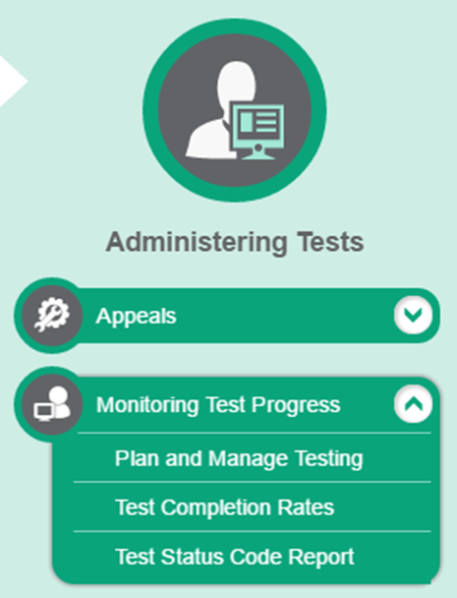
Monitoring Test Progress in TIDE
Several types of participation reports are available:
The Plan and Manage Testing Report details all of a student’s test opportunities and the status of those test opportunities.
The Test Completion Rates Report summarizes the number and percentage of students who have started or completed a test.
And the Test Status Code Report displays all the non-participation codes for a test administration.
Notes:
The tasks available in TIDE’s Monitoring Test Progress task menu allow you to generate various reports that provide information about a test administration's progress. These reports were previously available in ORS.
Several types of participation reports are available:
The Plan and Manage Testing Report details all of a student’s test opportunities and the status of those test opportunities.
The Test Completion Rates Report summarizes the number and percentage of students who have started or completed a test.
And the Test Status Code Report displays all the non-participation codes for a test administration.

Slide 74
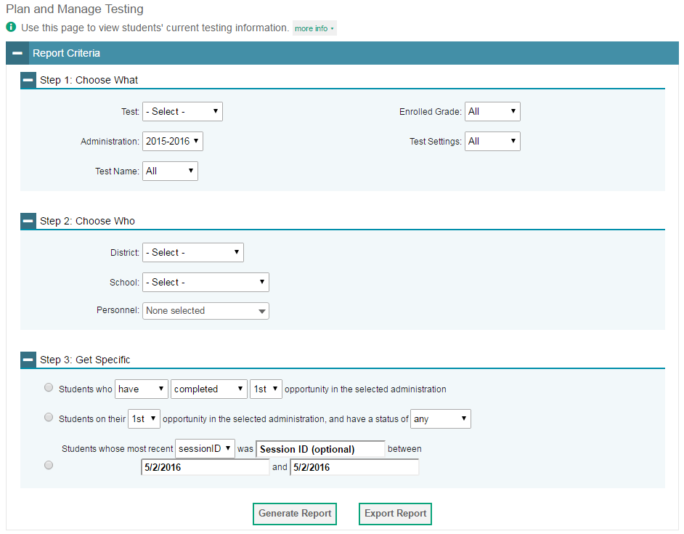
Plan and Manage Testing
Notes:
Plan and Manage Testing reports detail all of a student’s test opportunities and the status of each test opportunity. Because the report lists testing opportunities, a student can appear more than once on the report.
To generate a report from the Plan and Manage Testing page, first go to the Step 1: Choose What panel and select a test and administration. Optionally, you may also choose a test name, enrolled grade, or test settings.
Next, in the Step 2: Choose Who panel, select a district and school, if applicable. Optionally, you may also choose a teacher from the Teacher drop-down list.
Finally, in the Step 3: Get Specific panel, choose one of the three available options as desired and select parameters for that option.
Click Generate Report to view your Plan and Manage Testing report, or click Export Report to open the report in Excel.

Slide 75
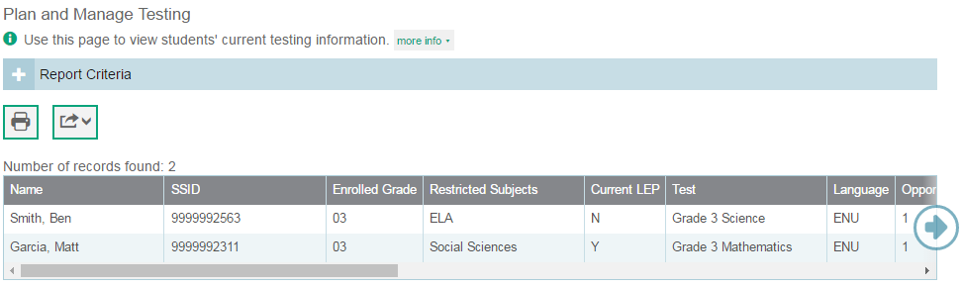
Plan and Manage Testing
Notes:
Clicking Generate Report will display the report and collapse the Report Criteria panel. Because not all columns can fit on the screen at once, you may need to click the blue arrow on the right side of the screen to scroll right and display more information.

Slide 76
Plan and Manage Testing
Which students have tested?
Which students tests have the TA/TE paused?
Did the TA/TE submit all the students tests in a session?
Notes:
This slide illustrates some common questions that can be answered using the options available in the Step 3: Get Specific panel.
To find students for whom the TA/TE have submitted tests, select the first radio button and search for students who have completed their first opportunity in the selected administration.
To find students for whom the TA/TE has paused tests, select the second radio button and search for students on their first opportunity in the selected administration with a status of paused.
To find out if the TA/TE submitted tests for all students in a test session, select the third radio button and search for students by test session ID between the dates when the test session took place.

Slide 77
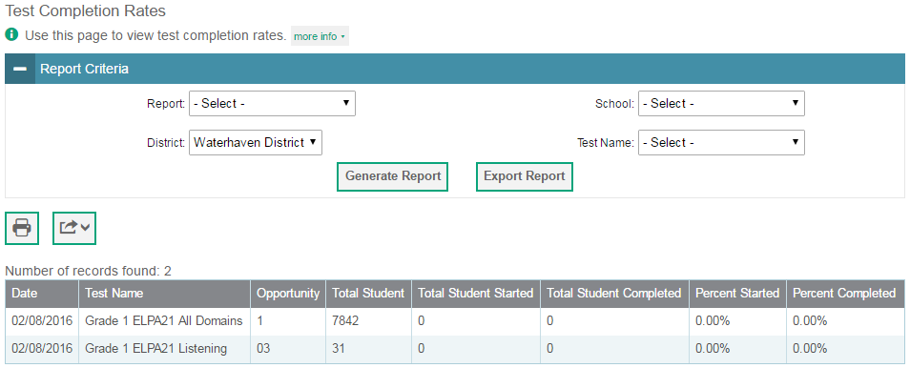
Test Completion Rates
Notes:
The Test Completion Rates report summarizes the number and percentage of students who have started or completed a test.
To generate a report from the Test Completion Rates page, choose whether to generate a District or School report from the Report drop-down list. Select a district and school from the corresponding drop-down lists, if available. If desired, select a test name.
To view the report on the page, click Generate Report. The report will appear below the Report Criteria panel. To open the report in Excel, click Export Report.

Slide 78
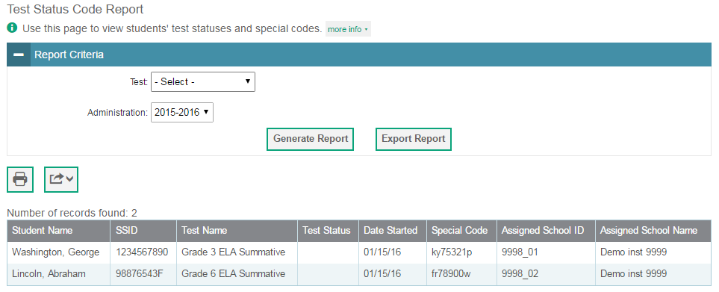
Test Status Code Report
Notes:
If a TA/TE does not start or submit tests for which a student is assigned, school officials assign non-participation codes to those tests indicating why the TA/TE did not start or submit the test. For information on particular terminology, policies, and procedures, please consult the Directions for Administration Manual.
The Test Status Code report displays all the non-participation codes for a test administration. To generate a report from the Test Status Code Report page, select a test and administration from the drop-down lists. To view the report on the page, click Generate Report. The report will appear below the Report Criteria panel. To open the report in Excel, click Export Report.

Slide 79
Important Final Dates
Last day of testing is April 14, 2017.
Materials must be returned on or before April 21, 2017.
Notes:
The last day of testing is April 14, 2017.
All printed materials must be returned to the contractor on or before April 21, 2017. Do not return foam shapes or other physical manipulatives you received.

Slide 80
Contact Information
For questions about test administration or receiving or returning materials:
Ohio Help Desk
1-877-231-7809
Ohhelpdesk@air.org
Notes:
For questions about test administration or receiving or returning materials, please contact the Ohio Help Desk by phone or by email.

Slide 81
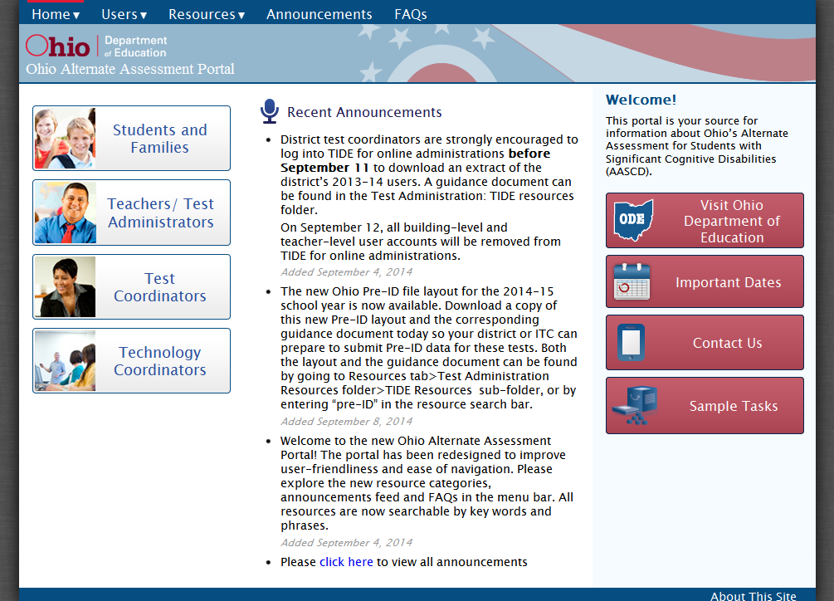
Alternate Assessment Portal
For more information:
Visit the Ohio Alternate Assessment Portal at http://oh.portal.airast.org.
    Note: No username or password is required to access the portal itself.
Access online systems
Find resources
FAQs
Notes:
You may also visit the Ohio Alternate Assessment Portal to access online systems, find resources, and read FAQs.

Slide 82
Additional Training
State Support Teams
Education.ohio.gov
Key Word Search State Support Team
Notes:
If you feel you would like additional face to face training or need additional support in how to administer the assessment, you can contact your regional state support team. Each state support team has at least one staff member who is a specialist in the alternate assessment. To find which region serves you, go to the Ohio Department of Education and search keyword State Support Teams.

Slide 83
Contact Information (cont.)
Andrew Hinkle
Office for Exceptional Children
andrew.hinkle@education.ohio.gov
(614) 466-2650
Jennifer Vaughn
Office of Curriculum and Assessment
jennifer.vaughn@education.ohio.gov
(614) 728-7434
Notes:
Finally, you may reach out to the Ohio Department of Education using the contact information shown here.
Thank you for viewing this training module. We wish you success in administering the AASCD.

